Slide 1
Colloquio interdisciplinare sulla biologia
Dinamica molecolare classica a supporto di esperimenti di cristallografia
Emiliano De Santis
Dipartimento di Fisica, Università degli studi di Roma Tor Vergata
INFN - Roma Tor Vergata

Slide 2
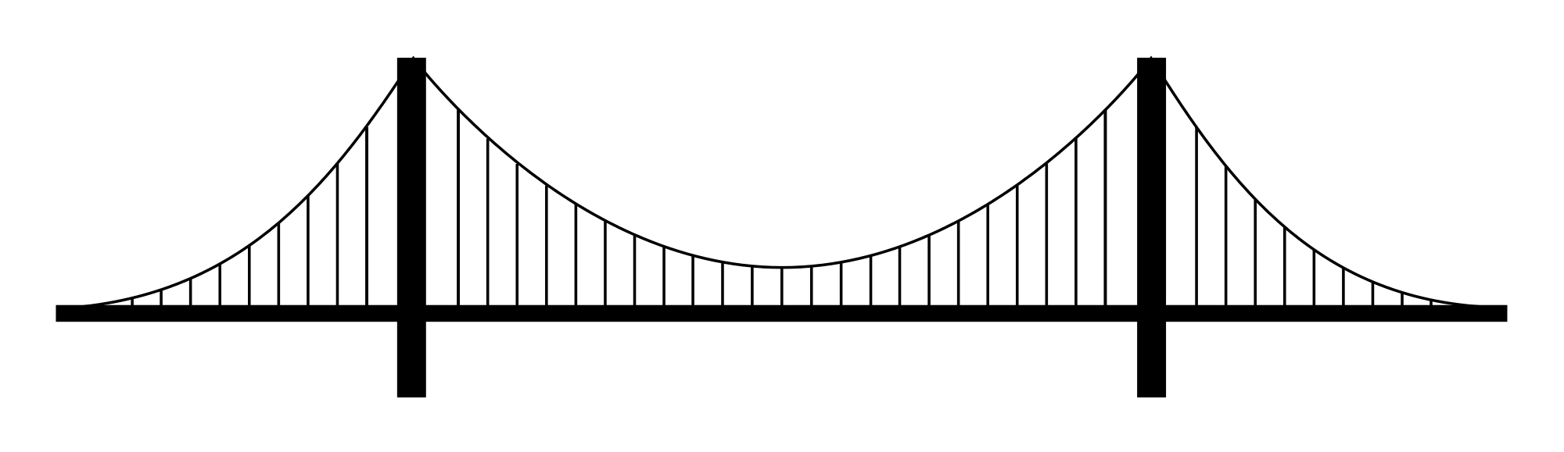
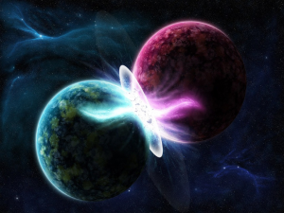
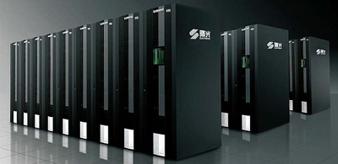
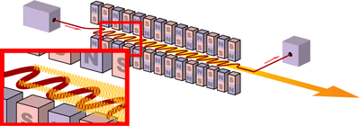
Experiments and theoretical calculations
A synergic approach
High-Performance Computing
& theoretical
models
Brilliant X-rays
(Synchrotrons & Free Electron Lasers)
Connecting two worlds
Protein structure and dynamics
Comprehensive picture of complex phenomena

Slide 3
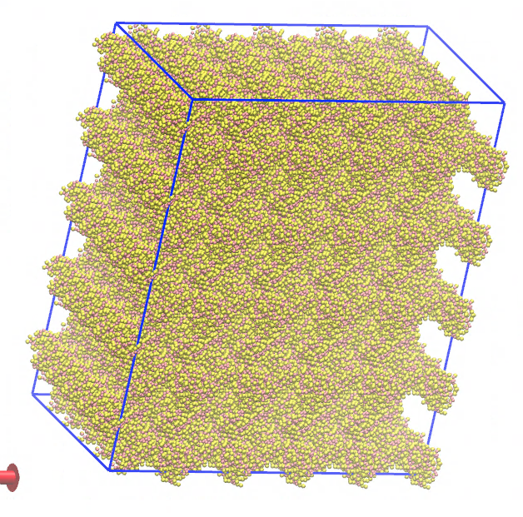
Outline
X-ray crystallography
Molecular Dynamics (MD) simulations
Coarse Grained-MD
for diffuse scattering

Slide 4
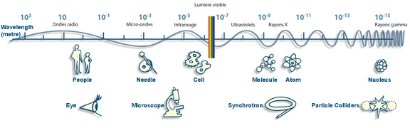
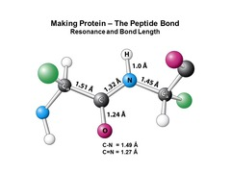
…why do we need X-rays?
λ_{x-rays} ~ 10⁻¹⁰ m = 1 Å → atomic resolution

Slide 5
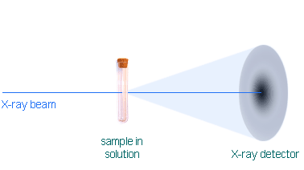
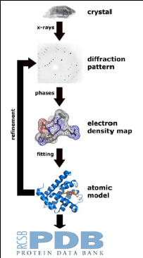
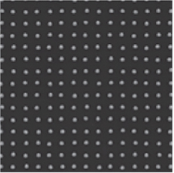
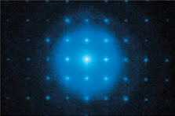
…why do we need a crystal?
The diffraction is due to the interaction of light (X-rays) with atoms
n λ = 2 d sin θ
The interaction of X-rays with a crystal gives rise to Bragg peaks
→ structural information can be extracted
Notes:
Bragg diffraction occurs when scattering amplitudes add constructively.

Slide 6
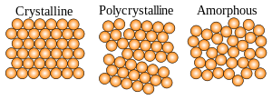
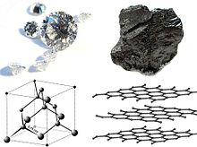
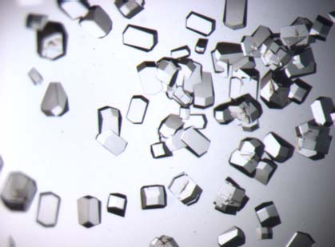
Crystals and Protein Crystals
A crystal is a solid in which the atoms are arranged in an ordered pattern extending in all three spatial dimensions
Diamond Graphite Lysozyme

Slide 7
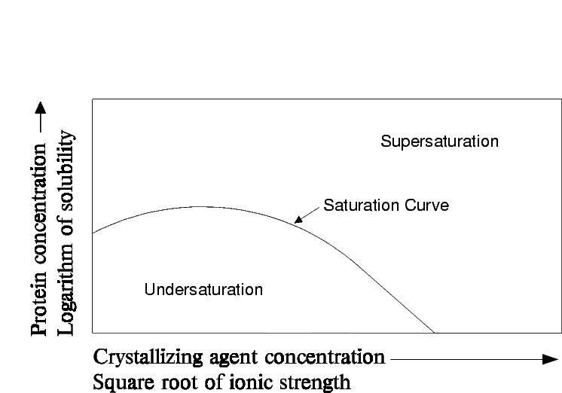
Protein Crystallization
Protein crystals can be obtained from supersaturated solutions
Proteins solubility is determined by many factors
-Temperature
-pH
-Salt concentration
- …
The main difficulty is to obtain relatively big and defect-free crystals
Notes:
Molecules tend to form crystals when the solution in which they are dissolved becomes supersaturated
Screening of several crystallization conditions is often necessary (and sometimes not sufficient) to grow ‘high quality’ protein crystals
‘high quality’ crystal:
-Not too many defects
-Big enough to give good SNR

Slide 8
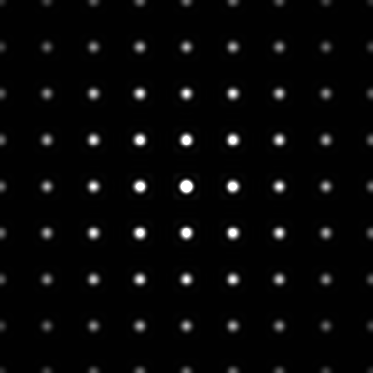
Diffraction from a perfect crystal
A perfect crystal yields perfectly ordered Bragg peaks
The perfect symmetry in the real space is reflected in a perfect symmetry in the reciprocal space

Slide 9

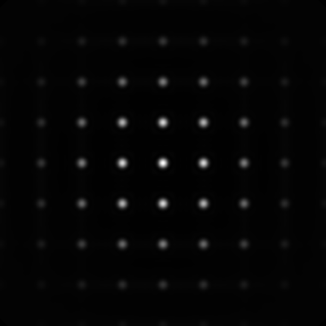
What if the crystal is not perfect??
After subtracting out the scattering from the Bragg peaks, what is left?
Random displacements
Displacements short-range correlated
Notes:
Bragg diffraction occurs when scattering amplitudes add constructively. If there is a defect in a crystal lattice (e.g. atom missing or in a slightly 'wrong' position), then the amplitude of the Bragg peak decreases. This 'lost' scattering intensity is redistributed into diffuse scattering. The diffuse scattering thus arises from the local (short range) configuration of the material (not the long-range structural order).

Slide 10
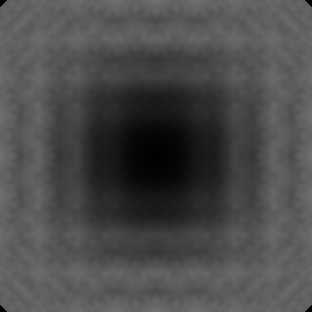
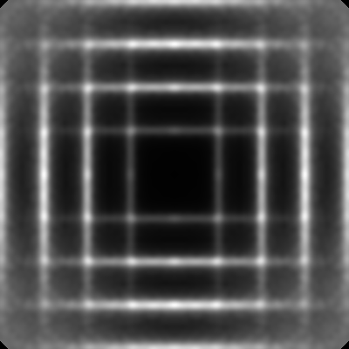
What if the crystal is not perfect??
After subtracting out the scattering from the Bragg peaks, what is left?
Random displacements
Displacements short-range correlated

Slide 11
Diffuse scattering
Diffuse scattering is the scattering that arises from deviations
from a perfectly regular lattice
Uncorrelated disorder yields “trivial” diffuse scattering contributions
Correlated disorder produces anisotropic diffuse scattering features whose spacing and intensity in reciprocal space are determined by length scale and amplitudes of the involved correlated displacements, respectively
Bragg reflections:
Info on the mean electron density
(->average structure)
Diffuse scattering:
Sensitive to spatial correlation in electron density variation
(-> related to protein functional motions)

Slide 12
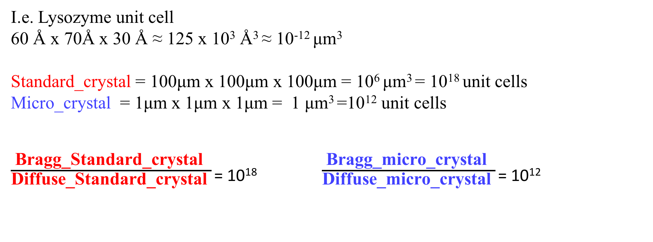
Why diffuse scattering is getting so popular (again)?
Thanks to new X-ray facilities (brilliant synchrotrons & FELs)
and beamlines it is getting easier to measure (without artefacts)
the diffuse scattering contributions
Welberry, et al, Crystall Rev 22.1 (2016)
Chapman, Henry N., et al. (2011)
Low-noise detectors
High dynamic range detectors
Nano-crystallography
I.e. Lysozyme unit cell
60 Å x 70Å x 30 Å ≈ 125 x 10³ Å³ ≈ 10⁻¹² μm³
Standard_crystal = 100μm x 100μm x 100μm = 10⁶ μm³ = 10¹⁸ unit cells
Micro_crystal = 1μm x 1μm x 1μm = 1 μm³ =10¹² unit cells
$\frac{\text{Bragg}\text{_}\text{Standard}\text{_}\text{crystal} }{\text{Diffuse}\text{_}\text{Standard}\text{_}\text{crystal} }$ = 10¹⁸ $\frac{\text{Bragg}\text{_}\text{micro}\text{_}\text{crystal} }{\text{Diffuse}\text{_}\text{micro}\text{_}\text{crystal} }$ = 10¹²
Bragg intensities scale with N², diffuse scattering intensities scale with N
The smaller the crystal, the easier to see diffuse intensities

Slide 13
Diffuse scattering models
Peck, et al., IUCrJ 5.2 (2018)
L
L
L
L
L
L
L
L
L
L
L
L
L
L
L
L
L
L
L
L
L
L
L
L
L
L
L
L
L
L
L
L
L
L
L
L
L
L
L
L
Rigid body rotation
L
Random disorder
L
L
L
L
L
L
L
L
L
L
L
L
L
L
L
L
L
L
L
L
L
L
Perfect crystal
L
L
L
L
L
L
L
L
L
L
L
L
L
L
L
L
L
Occupational disorder
Rigid body translations

Slide 14
Diffuse scattering models
How to model motions within a crystal?
How do these motions affect the diffuse scattering?
Molecular Dynamics simulations are a useful tool to model diffuse scattering patterns
starting from a realistic configuration
Héry, et al," J Mol Biol (1998)
Meinhold, et al., Biophys J (2005)
Wall, et al., PNAS (2014)
Wall, et al., bioRxiv (2017)

Slide 15
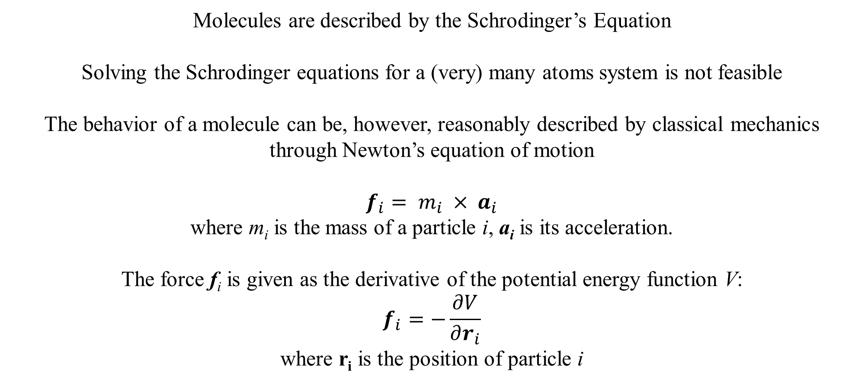
MD – a bit of theory
Molecules are described by the Schrodinger’s Equation
Solving the Schrodinger equations for a (very) many atoms system is not feasible
The behavior of a molecule can be, however, reasonably described by classical mechanics
through Newton’s equation of motion
$$f_{i}= m_{i} × a_{i}$$
where m_{i} is the mass of a particle i, a_{i} is its acceleration.
The force f_{i} is given as the derivative of the potential energy function V:
$$f_{i}=−\frac{∂V}{∂r_{i}}$$
where r_{i} is the position of particle i
\\\\\\\\\\\\\\\
\\\\\\\\\\\\\\\

Slide 16
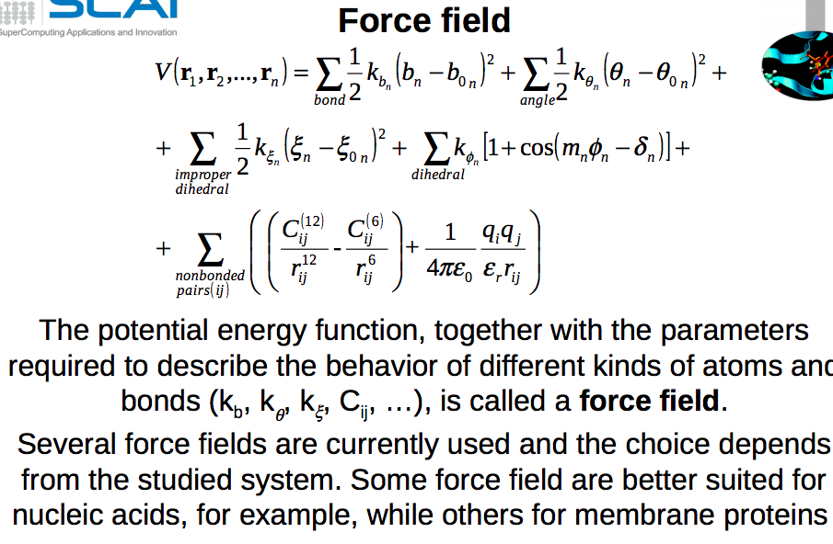
MD – Potentials
Potential Energy =
Bond STRETCHING energy
+ Angle BENDING energy
+ Dihedral TORSION energy
+ NON-BONDED interaction energy
(van der Waals + Coulomb)

Slide 17
MD – Potentials
Potential Energy =
Bond STRETCHING energy
+ Angle BENDING energy
+ Dihedral TORSION energy
+ NON-BONDED interaction energy
(van der Waals + Coulomb)
Potential energy function
Parameters
(k_{b}, k_{θ}, k_{ζ}, C_{ik}, ..)
Force field

Slide 18
MD simulations ingredients
System
(coordinates + velocities)
Input parameters
(dt, nsteps, cutoff, statistical ensemble, …)
MD
Force field
Trajectories
Analysis

Slide 19
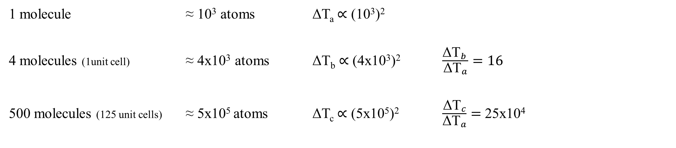
MD Scaling
Simulations time ∝ (N_{atoms})Log(N_{atoms}) , up to N_{atoms}²
1 molecule ≈ 10³ atoms ΔT_{a} ∝ (10³)²
4 molecules (1unit cell) ≈ 4x10³ atoms ΔT_{b} ∝ (4x10³)² $\frac{{\text{ΔT}}_{b }}{{\text{ΔT}}_{a}}=16$
500 molecules (125 unit cells) ≈ 5x10⁵ atoms ΔT_{c} ∝ (5x10⁵)² $\frac{{\text{ΔT}}_{c}}{{\text{ΔT}}_{a}}=$ 25x10⁴
MD simulations
for a crystal could be very time consuming!!!
Smallest bio-crystal analyzed ≈ 10⁴ unit cells

Slide 20
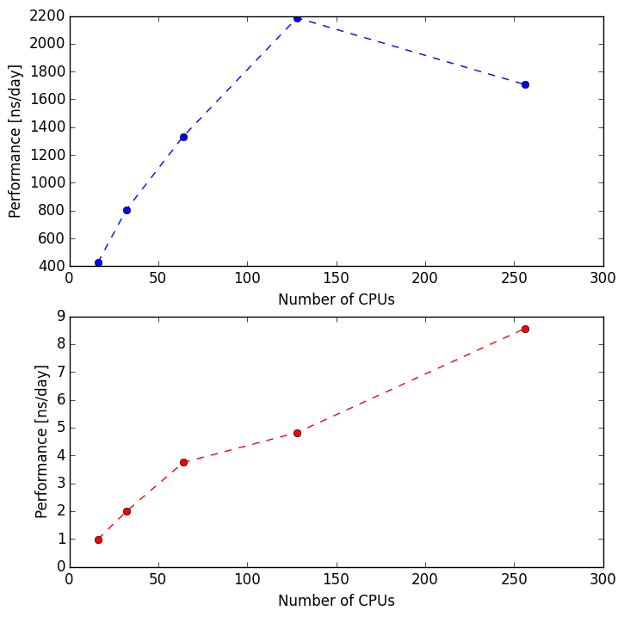
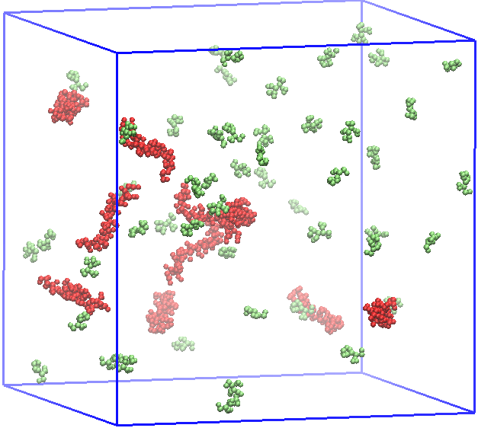
Coarse Grained MD strategy
Coarse grained (CG): suitably chosen groups of atoms are treated as a elementary
objects (beads) of the systems
Performance vs number of CPUs
Reducing system DOF
CG
16 32 64 128 256
Increasing the simulations timestep (dt)
Number of CPUs
Number of entities:
CG: 180K beads
AA: 1.3M atoms
aa
Gaining performance (simulation can approach the ms timescale)
16 32 64 128 256
Number of CPUs
$$\frac{{Performance}_{CG }}{{Performance}_{AA}}≈400$$
Simulations are performed on Intel Xeon E5-2697 v4 (Broadwell) at 2.30 GHz with GROMACS 5.1.2 version
Notes:
Molecular dynamics simulations is a widely used computational tool to describe the collective motions of a system of interacting particles. Traditionally, every atom in the system is represented explicitly. Although such an all-atom approach provides high accuracy, it is computationally very expensive and therefore limited to small system sizes (e.g., a single protein) and short time scales (nanoseconds). To alleviate this problem, coarse-grained (CG) models have gained a lot of popularity in the field of molecular simulations lately. By uniting small groups of atoms into effective interaction sites (“beads”), the simulation costs are strongly reduced and the temporal evolution of much larger systems can be followed over much longer time scales.

Slide 21
Coarse Grained MD – Martini force field
The force field has been parameterized in a systematic way, combining top-down and bottum-up strategies
Non bonded interaction: reproduction of experimental partitioning free energy between polar and apolar phases
Bonded interactions:
derived from reference
all-atom simulations
Aminoacid mapping
The model uses a four-to-one mapping, i.e. on average four heavy atoms and associated hydrogens are represented by a single interaction center. In order to keep the model simple, only four main types of interaction sites are defined: polar, non-polar, apolar, and charged
Marrink et al., JPhysChemB (2007)
Monticelli et al., JCTC (2008)
Poma, et al., JCTC (2017)

Slide 22
CG-MD for diffuse scattering
MD is a powerful tool to model the diffuse scattering
CG-MD allows to study the motion of atoms among more than one unit cell
CG-MD allows to simulate long timescales (up to μs)
Unit cell
Supercell

Slide 23
CG-MD for diffuse scattering
CG-MD simulations of a lysozyme nanocrystal
diffuse scattering pattern simulated along the MD trajectory

Slide 24
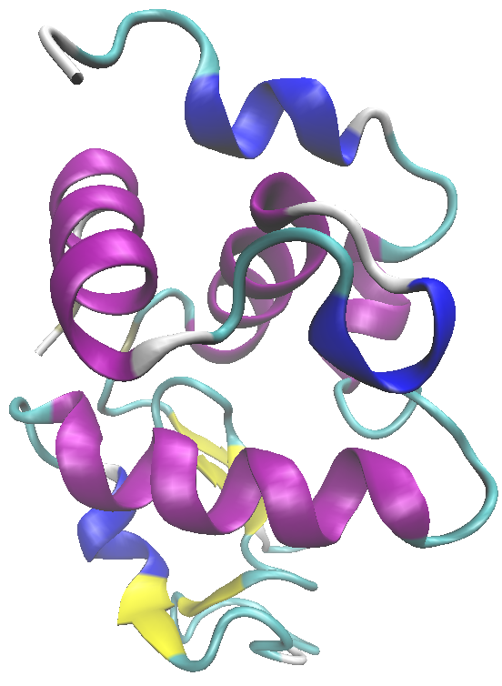
The system
Lysozyme is an antimicrobial enzyme
It can be considered as the ‘hydrogen atom’
of structural biology
Abundant
Easy to purify
Well known system
1 molecule
≈1000 atoms
129 residues

Slide 25
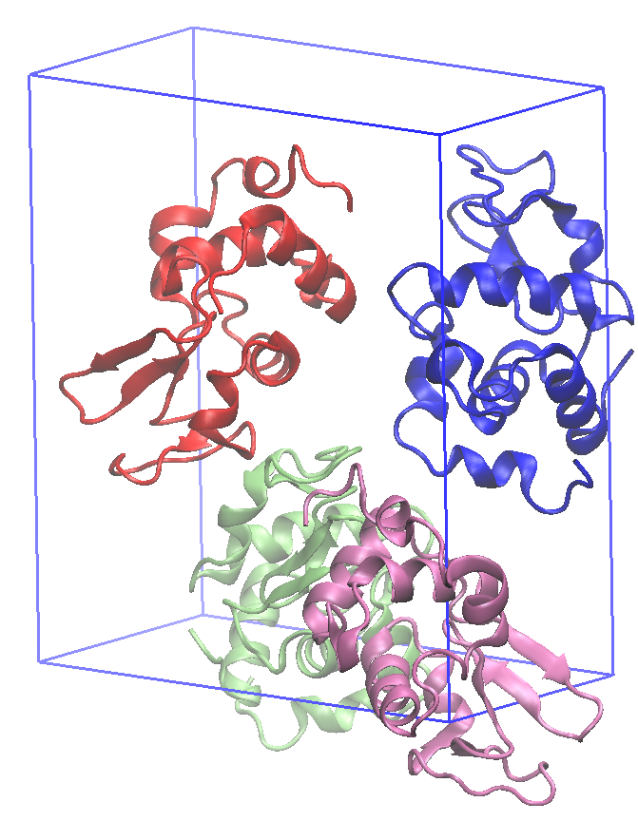
The system
30.52Å
59.06 Å
Orthorhombic unit-cell of lysozyme
(pdb ID: 1AKI)
P2₁2₁2₁ space group
68.45 Å
4 molecule
≈ 4000 atoms
516 residues
P. Artymiuk, et al, Acta Crystallographica
Section B: Structural Crystallography and Crystal Chemistry 1982.

Slide 26
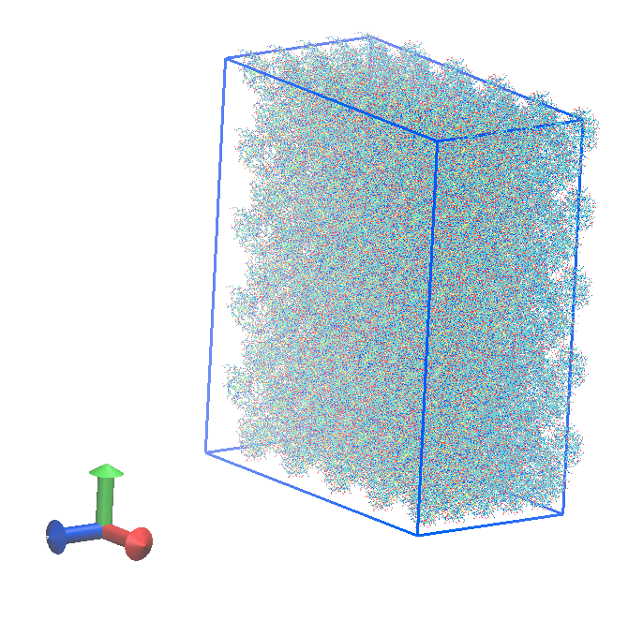
The system
Orthorhombic super-cell of lysozyme composed by 125 unit cells (500 proteins)
500 molecules
≈ 500K atoms
+ 180K water molecules (36% of the crystal volume)

Slide 27
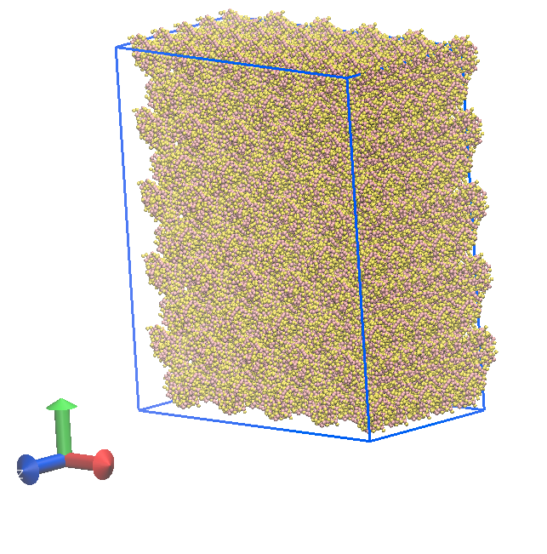
The system
From All Atom representation to CG
Orthorhombic super-cell of lysozyme composed by 125 unit cells (500 proteins) in the CG representation
500 molecules
≈ 140K beads
≈ 45K water beads

Slide 28
Simulation protocol
Relaxation in vacuum
using SD
Crystal construction
Solvatation & ions addition
Simulations required 13k core hours on HPC
160k snapshots collected
Trajectory file > 100Gb
Mapping to CG
Relaxation of the solvated supercell using SD
Python code
de Jong, et al., J Chem Theor and Comp (2012)
Gowers, et al., Proc of the 15th Python in Science Conf2016.
NPT ensemble dynamics
(T=300K, p=1bar,
dt=20fs, Δt=3.3 μs),
PBC employed
Abraham, et al.,TSoftwareX (2015)
Gromacs suite

Slide 29
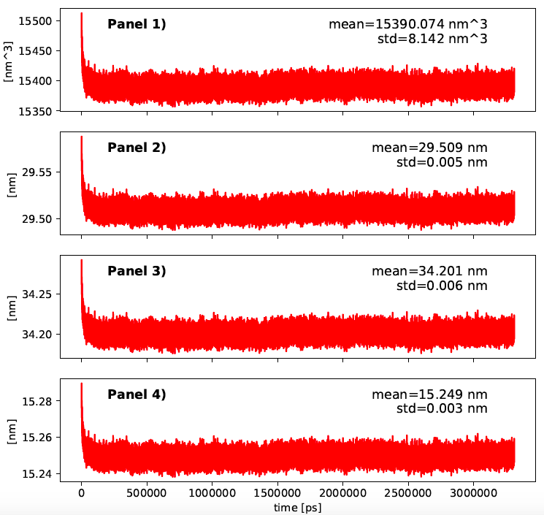
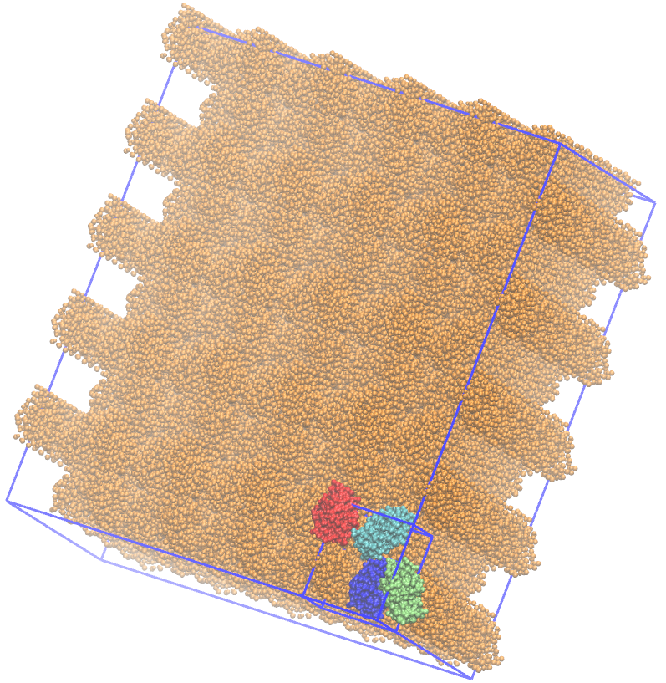
NPT
Monitoring the simulation box volume
Simulation protocol
Volume vs time
X vs time
Y vs time
Z vs time

Slide 30
Simulation protocol
Monitoring RMSD
Douglas, et al., Acta Crystallographica A 61 (2005)

Slide 31
The diffuse scattering intensity
Diffuse scattering patterns are simulated from 45K snapshots extracted along the equilibrated CG-MD trajectory
C + OpenCL code
K. Ayyer, “Incoherent diffractive imaging simulations." https://github.com/kartikayyer/incoh-imaging, 2017
Diffuse scattering features

Slide 32
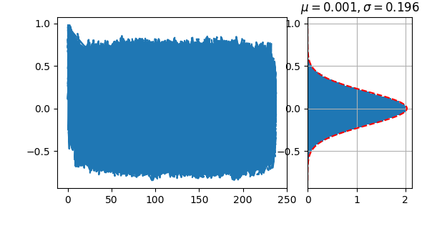
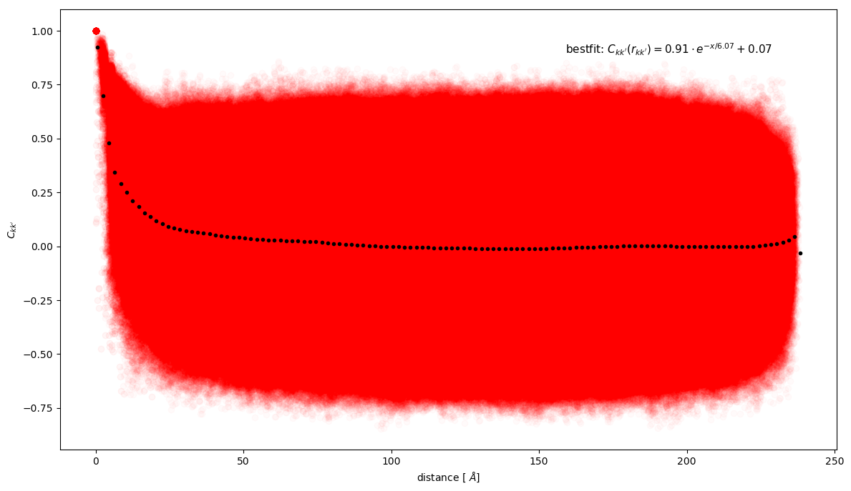
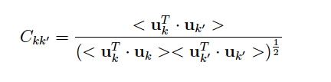
Correlations vs distance
For a pair of atoms kk’, the correlated motion is characterized by the normalized matrix element C_{kk’} with
Ckk’
u_{k}= displacement of the atom k
Distance [Å]
The correlations decrease with the distance

Slide 33

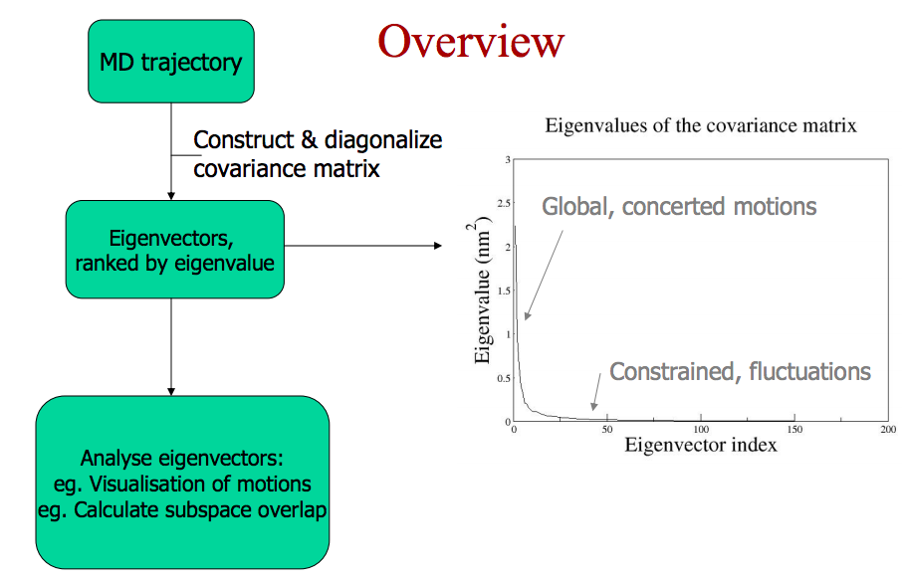
Principal component analysis
MD trajectory
Construct & diagonalize
covariance matrix
Eigenvectors,
ranked by eigenvalue
Eigenvectors analysis:
visualization of “filtered” motions
Amadei et al, Protein Struct Funct Genet, 1993

Slide 34
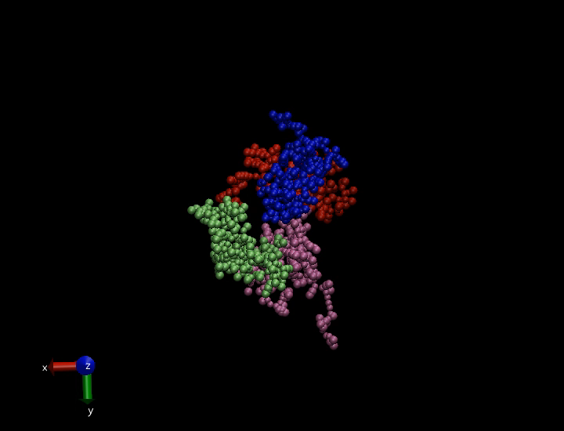
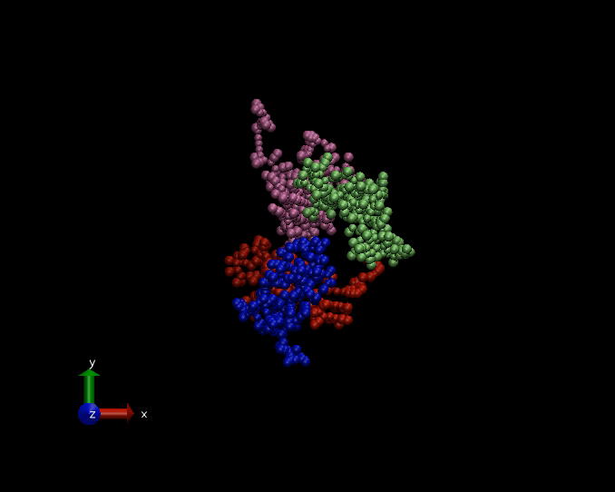
Principal component analysis
Animation of the motion on one unit cell along the first (sx) and the second (dx) eigenvectors

Slide 35
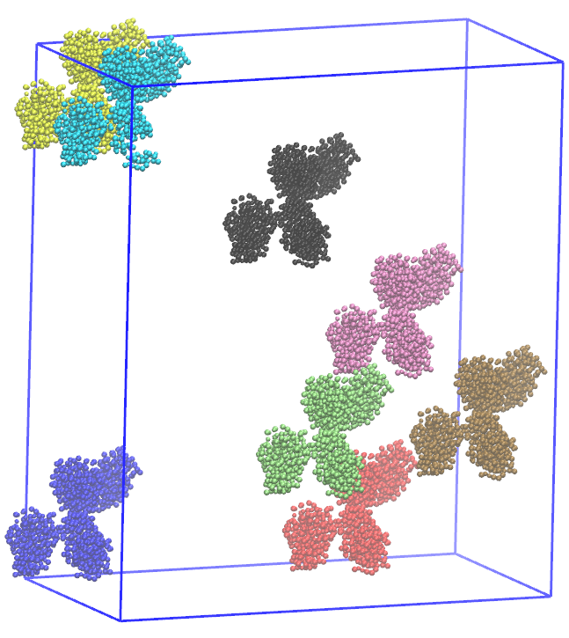
Principal component analysis
Analysis performed independently on 8 different unit cells
Is the crystal homogeneous?
Are there collective motions?

Slide 36
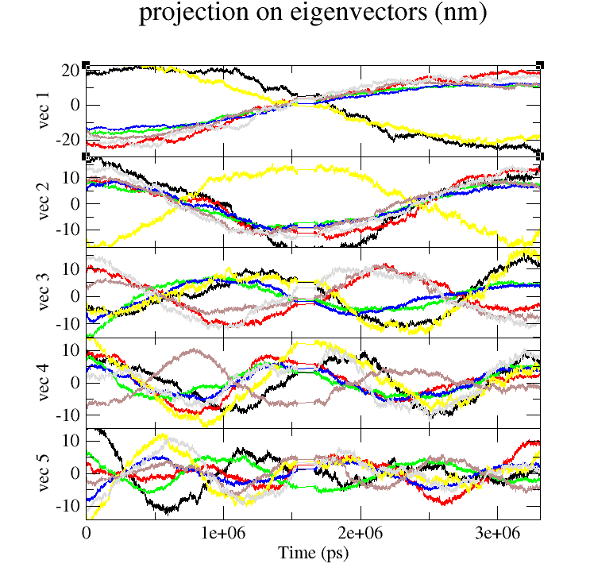
Principal component analysis
Projection on eigenvectors
Projection of the trajectory on the first 5 eigenvectors
Proj(t)= trj(t) • eigenvector_j
j={1:5}
Each colored line refers to the analysis performed on a different unit cell

Slide 37
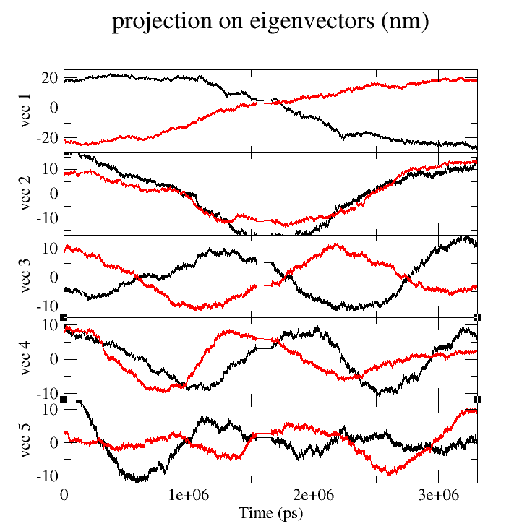
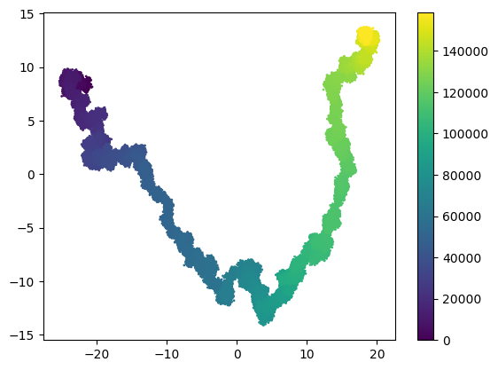
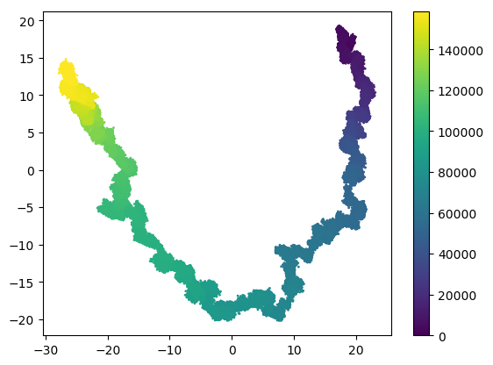
Principal component analysis
FOCUSING ON 2 UNIT CELLS
2D projection:
Each point P(t) in the plot has coordinates:
P(t)= (trj(t) • eigenvector_1 ; trj(t) • eigenvector_2)
Projection on eigenvectors

Slide 38
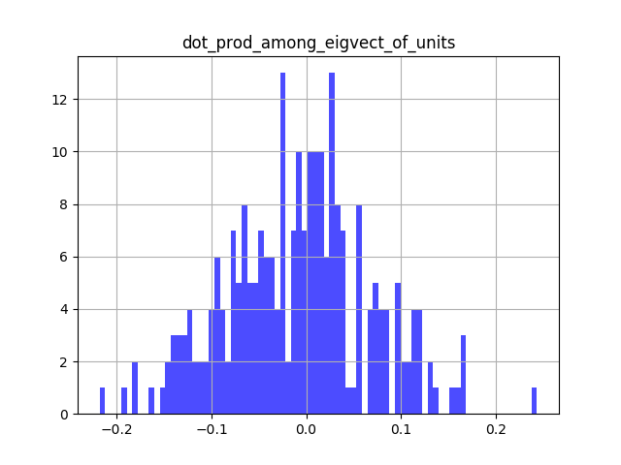
Principal component analysis
Scalar product among eigenvectors of different unit cells
It seems that the eigenvectors are
not “parallel”
Is there a correlation among beads motions in different unit cells?
Looks like the answer is “no”…

Slide 39
Diffuse scattering in Lysozyme crystals is a weak contribution
The correlation among atoms obeys the liquid like motion
Our findings are thus in line with experimental data
Experimental evidences
Héry, et al," J Mol Biol (1998)

Slide 40
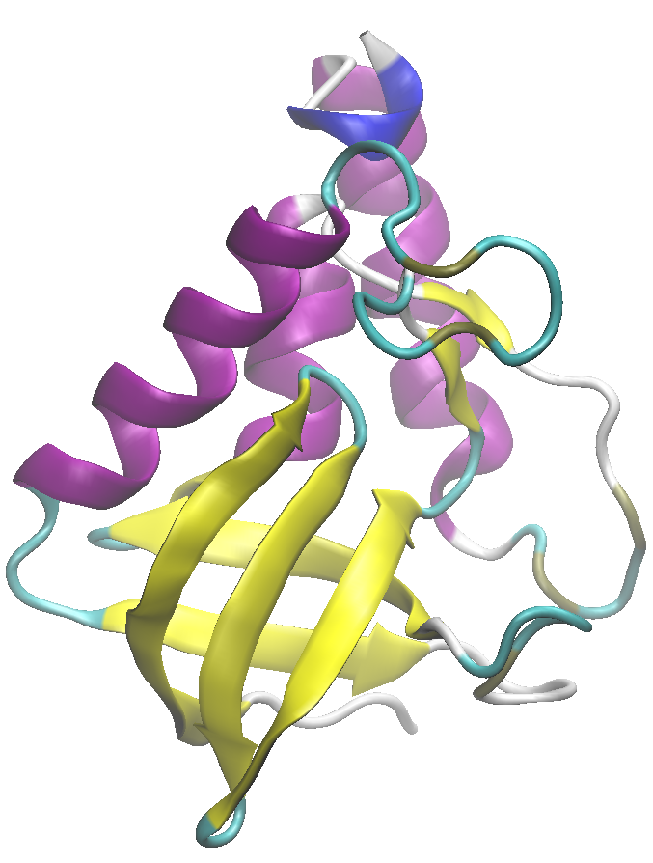
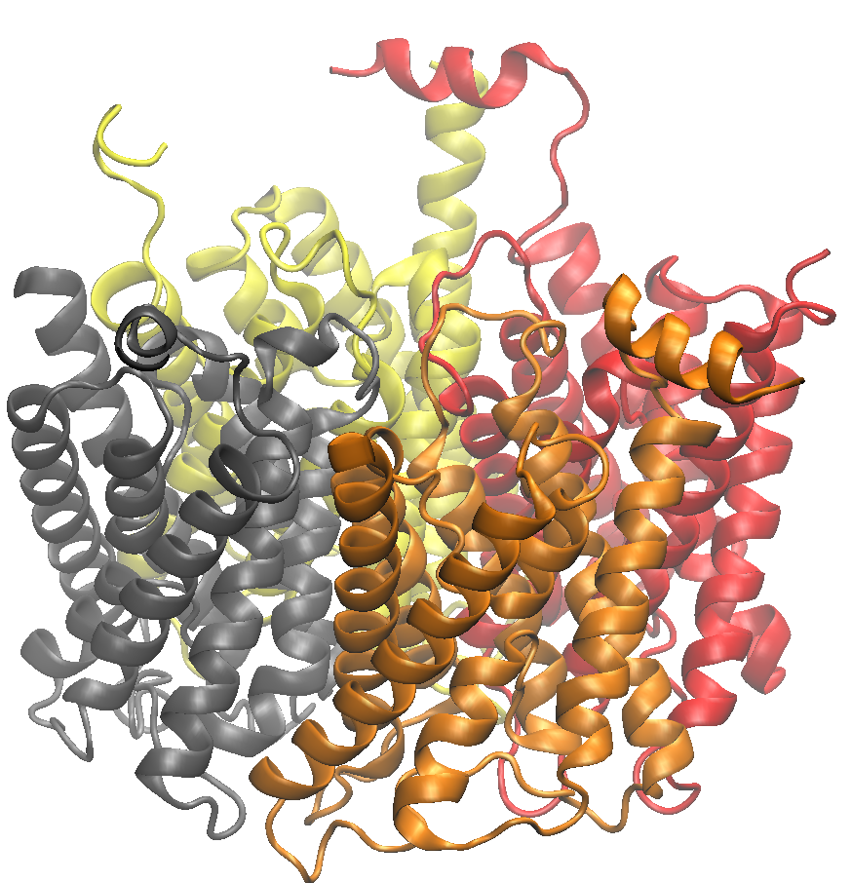
Work in progress…
Staphylococcal nuclease (pdbID 1stn)
(≈ 1000 atoms, several diffuse scattering datasets available)
Hynes, et al., Proteins: Struct, Funct, and Bioinformatics (1991)
Human Aquaporin 2 (pdbID 4nef)
(large protein complex, ≈ 7000 atoms + surfactants,
diffuse scattering data available)
Horsefield, et al., PNAS (2008)

Slide 41
Conclusion
We are able to perform CG-MD simulations of nanocrystals
We set up a protocol to reproduce diffuse scattering patterns from CG-MD configurations
We are able to quantify collective atomic motions in protein crystals

Slide 42
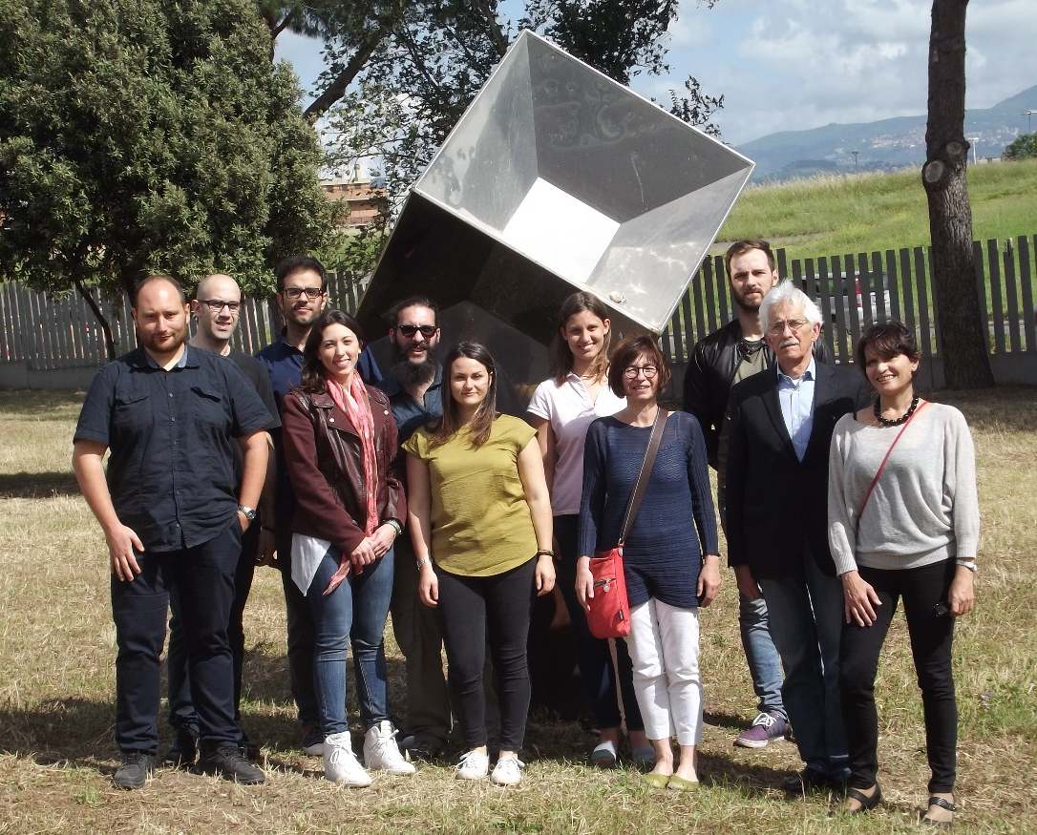
Acknowledgements
The Biophysics Group in Tor Vergata
http://biophys.roma2.infn.it
A Amadei
S Morante, G C Rossi, V Minicozzi, F Stellato,
E De Santis, A Dhar
H Chapman, K Ayyer
Notes:
Last, I would like to thank all the members of the biophysics group of the Tor Vergata University in Rome and all of you for your attention

Slide 43
Thank you for the attention…..

